Slide 1
AI Ergonomic chair
Need/Want/Users/Market

Slide 2
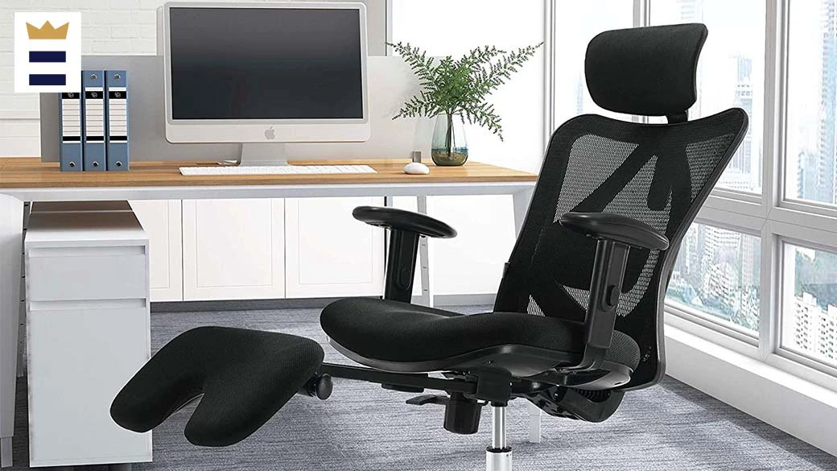
What is product need?
The bending design of the chair provides complete back support.
Adjusted to maintain a small backward tilt.
By adding or removing additional elements, they may customize their chairs to suit each individual and body form.
The chair is made of net, which absorbs sweat better than canvas, which is commonly used in chairs.

Slide 3
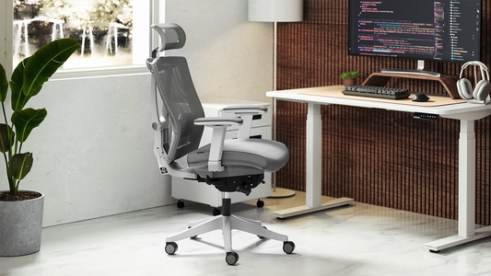
What is product want to?
Helping people feel more comfortable and reduce likelihood of getting from the spine or skin.
Increasing productivity.

Slide 4


What is types of users?
Office workers
People who have a computer setup

Slide 5
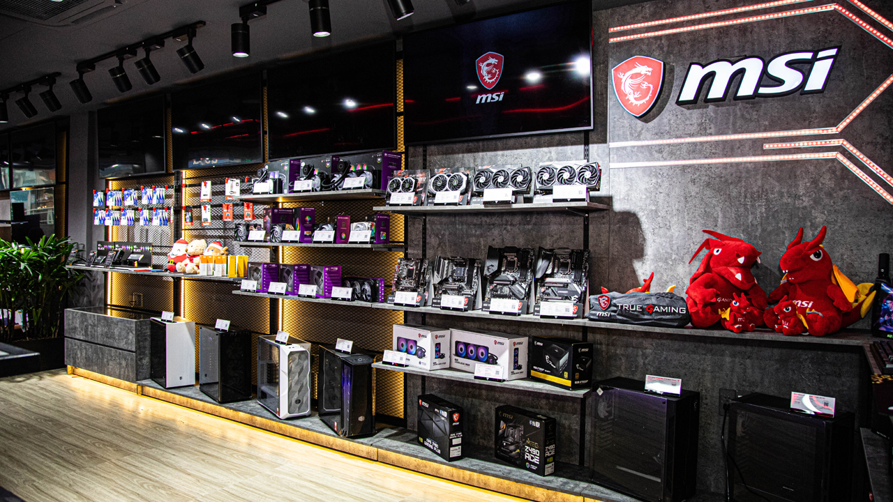
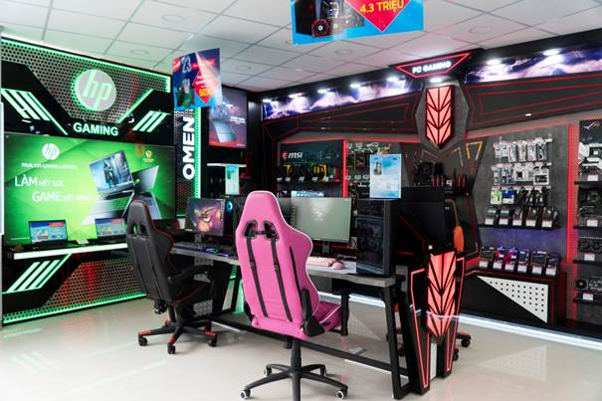
Where does us choose for market?
Stores have online and face-to-face shopping.

